Slide 1
Gibela Exco strategy
proposal for facilitation
november 2025

Slide 2
The Gibela Exco needs to review the progress against its KPIs and strategise to deal with key market developments
Gibela faces challenges due to its client’s decisions to reduce offtake volumes and safety challenges with its product
1
2
3
Review progress against KPIs
Adjust strategy to accommodate client’s request to reduce train volumes
Address safety challenges with the product
Exco KPIs have been agreed with the board
Gibela is currently engaging with PRASA on potentially reducing the volume of train offtake
There have bee a number of challenges related to the safety of the trains being produced
Gibela exco members need to provide feedback and account to each other as to their performance, identify obstacles and agree on how these can be overcome
There is a need to align around an appropriate negotiating strategy with PRASA
There is a need to align as an exco team around what the root cause of these safety issues are and what needs to be done to address these
The Exco workshop will seek to align on progress made and on the way forward for key strategic issues

Slide 3
AIA will assist in the preparation and facilitation of the exco workshop
AIA’s support will comprise engagement with exco members, assisting in the development of material for the exco session, facilitation of discussions during the session and compilation of post meeting report
1
2
3
Engagement with exco members
Preparation of material
Strategy session facilitation
Engaging with individual exco members
Preparing templates to assist exco members with their presentation
Facilitate exco session over 1,5 days
Align on the progress that has been made against KPIs
Align on the state-of-play wrt. PRASA’s train volume cutback
Align on train safety issues that need to be elevated to exco
Ensure that progress updates are adequately crafted and the challenges well articulated to ensure a productive session
Ensure a consistent look and feel and content across the different presentaitons
Facilitation will consist of a combination of exco presentation and facilitated discussions on the way forward
AIA’s role will be to ensure that the exco session is meaningful and secures tangible outcomes to address the challenges the company faces

Slide 4
The proposed agenda for the first day will be to focus on progress on KPIs and then framing the discussion regarding the key challenges
Time | Item | Structure | Presenter/Facilitator
08:00 – 08:20 | Welcome and setting expectations | Discussion | CEO
08:20 – 08:50 | Review and discuss KPIs of key exco members | Presentation an discussion | Soraya Mccann
 |  |  | Junior Ledwaba
08:50 – 09:20 |  |  | Junior Ledwaba
09:20 – 10:00 |  |  | Vuyiswa Tlomatsane
10:00 – 10:20 | Refreshments
10:20 – 10:50 | Review and discuss KPIs of key exco members | Presentation and discussion | Piet Mahlangu
10:50-11:20
10:50-11:20 |  |  | Dr. Buyiswa Mncono-Liwani
11:20 – 12:00 |  |  | Reggie Boqo
12:00 – 13:00 | Lunch
13:00-13:30 | Review of outcome from KPI discussions | Facilitated discussion | AIA
13:30 – 15:00 | Review of PRASA cutback scenarios, financial implications (Discussion to define key options) | Presentation and facilitated discussion | Soraya Mccann – AIA
15:00 – 16:30 | Review of safety challenges an implications (Discussion to align on problem and framing way forward) | Presentation and facilitated discussion | Junior Ledwaba - AIA

Slide 5
The second day will focus on converting the high level framing and options identification on day 1 into convergence around the way forward
Time | Item | Structure | Presenter/Facilitator
08:00 – 08:30 | Recap of day one | Presentation | AIA
08:30 – 10:00 | Facilitated discussion to align on actions to address PRASA train cutbacks | Facilitated discussion | AIA
10:00 – 10:20 | Refreshments
10:20 – 12:00 | Facilitated discussion to align on actions to address safety concerns | Facilitated discussion | AIA
12:00 - 12:30 | Closing |  | AIA/CEO
12:30 – 13:30 | Lunch

Slide 6
The budget for the facilitation includes the cost of engaging with exco in preparation, conducting research on the market opportunity & facilitating the board session
Proposed Costing
Preparation for session – engagement with exco members, preparing templates etc.
RR 130, 000
Facilitate exco session
RR 120, 000
VAT
RR 37,500
Total
RR 287,500

Slide 7
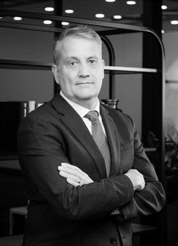
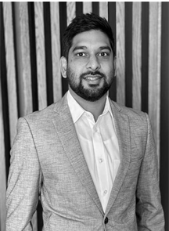
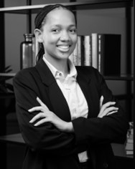
The session will be facilitated by an experienced and skilled team
Henry Gilfillan is the Integrated Energy Practice Leader at AIA. Henry holds an Honours degree in Accounting Science (BCompt Hons) from the University of South Africa. He has 20 years’ experience in finance, strategy, business development and regulatory engagement in the energy and chemical industries. He held senior positions in the areas of strategy, regulatory engagement and business development at South Africa’s leading energy and chemicals company. During this time, he successfully led several multi-disciplinary teams on projects ranging from scenario and strategy development to the development of gas supply options for South Africa and engagements on climate change, carbon tax and energy policy. Henry was most recently the Vice President of Strategic Intelligence at Sasol, some notable achievements in his time at Sasol were:
The conceptualisation, development and negotiation of an innovative competition law remedy that allowed Sasol to settle an abuse-of-dominance competition law case against it in its fertiliser business;
The formulation of a 2050 strategy for Sasol’s southern African business that formed the basis of the company’s decision to more aggressively pursue gas resources and lower carbon alternatives;
Henry Gilfillan
Manish Ramjewon is a versatile and accomplished professional, currently pursuing a Ph.D. in Hydrology at the University of KwaZulu-Natal. Known for scholarly contributions with two published research papers. He holds a diverse academic background including an MSc in Hydrology complemented by qualifications in Civil Engineering and Geography.
His expertise transcends academia into the practical realm where he has crafted tools that drive efficiency and smart decision-making, addressed revenue leakage with innovative solutions and delivered data-driven insights for listed companies which reflects a commitment to actionable analytics. He played a pivotal role in creating automated data processing models, amplifying client productivity.
Manish Ramjeawon
Ayodele Morobi is a consultant at AIA and holds a BSc Honours in Chemical Engineering. She is a dynamic thinker with experience in innovative problem solving. Since joining AIA, she has specialised in market analysis, business model design and strategy development. She is particularly skilled in research and analysis, problem framing and strategic thinking.
Ayodele Morobi

Slide 8
Thank you

